Slide 1
RyniXsoft Hybrid Internship Week -1
BY
SWETHASUPRIYA AS
UI/UX DESIGNER

Slide 2
Why Choose the Problem: Digital Talent Management System (DTMS)?
Employees in today's organizations, particularly those in the IT and digital sectors, are always changing roles, improving their skills, and working on dynamic projects. But a lot of businesses still use the following methods to manage talent: Excel documents Emails Different HR software programs Tracking performance manually Data fragmentation and inefficiency result from this.
By consolidating all talent-related tasks onto a single platform, a digital talent management system addresses this.

Slide 3
What challenges does the user face?
What problem does your product solve ?
• Difficulty finding suitable internal job opportunities
• Lack of clear visibility into career growth paths
• Long and complicated application process
• No real-time updates on application status
• Delayed feedback from HR or managers
• Provides clear visibility of internal job openings
• Simplifies the job application process
• Enables employees to track their application status in real time
• Offers transparency in career growth opportunities
• Improves communication between employees and HR teams

Slide 4
Why Good UX is Important ?
How Better Design Improves User Experience ?
Makes the system easy to use and understand
• Saves users’ time by simplifying tasks
• Reduces user frustration and errors
• Increases user satisfaction and engagement
• Helps users achieve their goals quickly
• Clear navigation helps users find information easily
• Simple forms reduce effort while applying for jobs
• Smart search and filters help users find suitable roles faster
• Real-time notifications keep users informed about status updates
• Clean dashboards improve visibility of skills, jobs, and progress

Slide 5
Why This Problem Is Important
Modern organizations increasingly rely on digital talent. However, many mid-sized companies still lack unified platforms like:
WorkdaySAP
SuccessFactors
Oracle HCM Cloud
These platforms show strong demand for talent management systems, but they are often complex and expensive. There is an opportunity to design a simplified, user-friendly solution.

Slide 6
Who are the Target Users?
1. HR Manager / Admin
Oversees workforce planning
Tracks performance analytics
Generates reports
2. Recruiter
Manages candidate pipeline
Screens resumes
Schedules interviews
3. Employee
Updates skills
Applies for internal roles
Tracks performance feedback
4. Department Manager
Assigns team members to projects
Reviews team performance
Identifies skill gaps

Slide 7
Details User Persona
Persona 1 – HR Manager
Name: Ananya Rao Age: 38 Experience: 12 years in HR
Goals:
Centralized workforce visibility
Faster report generation
Reduce manual effort
Persona 2 – Employee
Name: Arjun Kumar Age: 26 Role: Software Developer
Goals:
Clear promotion path
Internal job visibility
Skill development tracking
Persona 3 – Recruiter
Name: Meera Singh Age: 30
Goals:
Faster resume filtering
Organized hiring process

Slide 8
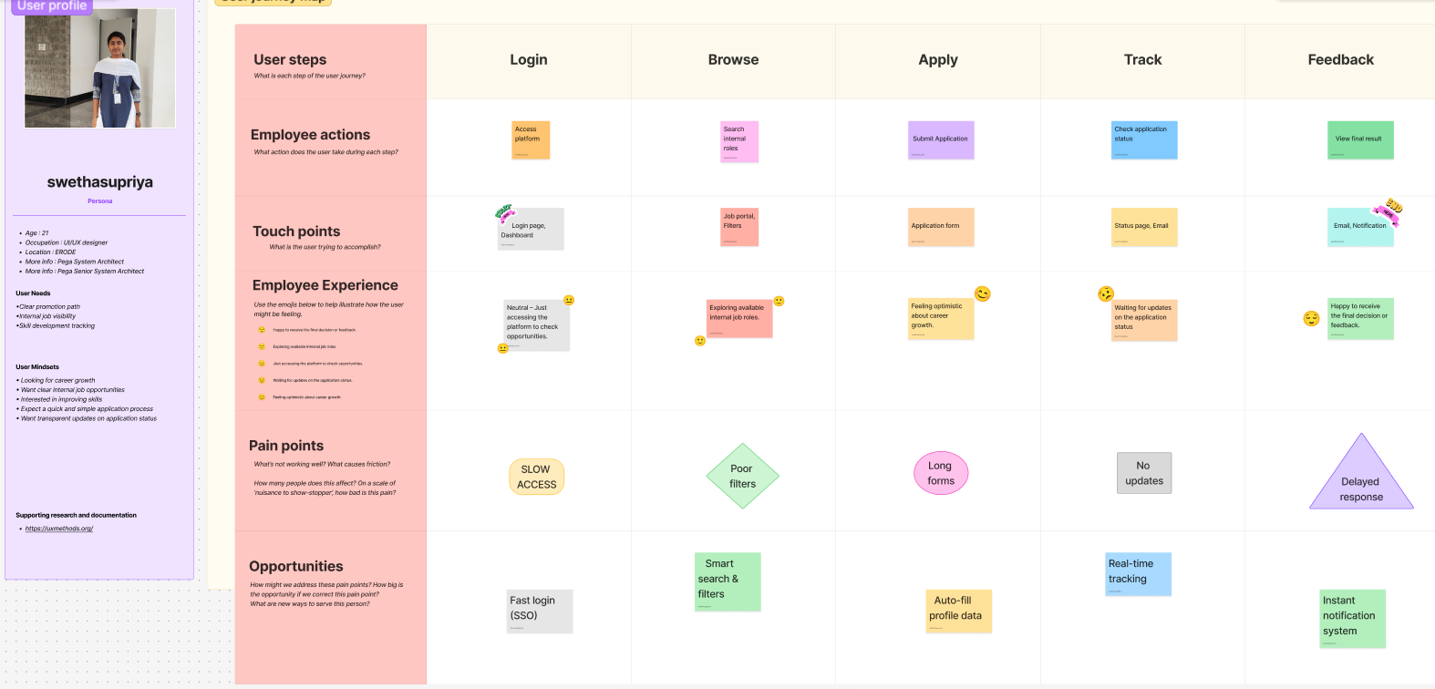
USER JOURNEY MAPPING

Slide 9
Employee Flow Diagram
Start
Login
Dashboard
View Internal Jobs
Filter/Search
Apply
Track Status
Receive Notification
End

Slide 10
HR Talent Review Flow
Start
Login
View Skill Matrix
Access Dashboard
Analyse Performance
Generate Report
Approve / Reject Application
End

Slide 11
UX Strategy Direction
1. Simplicity
Clean dashboards with minimal navigation depth.
2. Role-Based Personalization
Different dashboards for:
HR
Recruiter
Employee
Manager
3. Transparency
Clear status tracking and feedback visibility.
4. Data Visualization
Use charts and metrics for workforce insights.
5. Efficiency
Reduce manual steps and automate repetitive tasks.

Slide 12


